Slide 1
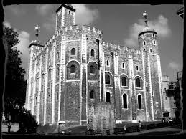
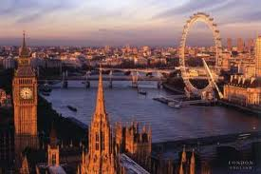
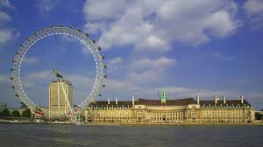
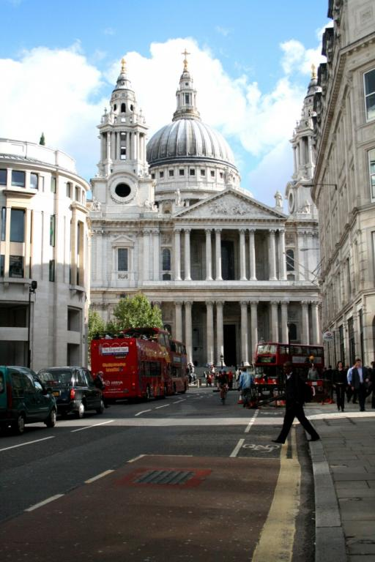
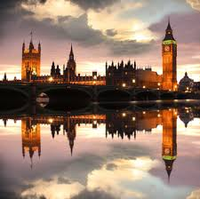
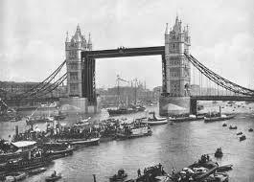
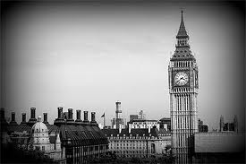
ENGLAND
between past and present!
BY LAURENA CARVALHO 4°B

Slide 2
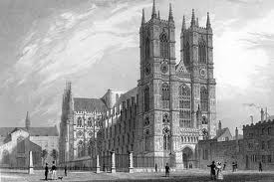
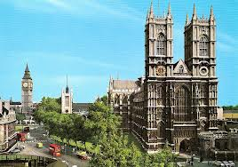
Westminster abbey
The palace of Westminster in the city of
Westminster, LONDON, United kingdom
XIX CENTURY ENGLAND.
Westminster Abbey is a mixture of
architectural styles , but considered the
finest example of Early English Gothic
( 1190 / 1300 ). It’s not merely a beautiful
place of worship , though .
BUILT : MIDDLE AGES (XIX CENTURY ENGLAND)
DEMOLISHED : 1834 (DUETO FIRE)
Rebuilt : 1840-1870

Slide 3
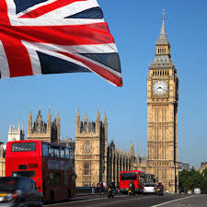
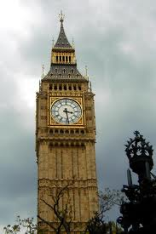
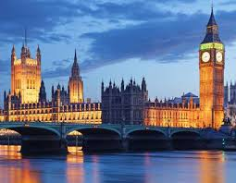
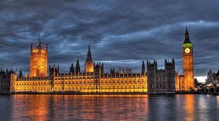
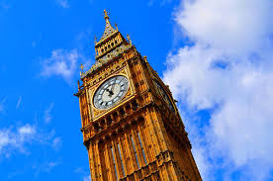
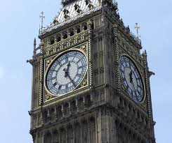
XIX century England.
The Clock Tower of the palace of Westminster ,
officially named Saint Stepen’s tower , is commonly
known as the Big Ben. The Tower was constructed
between 1843 and 1858 as the clock
Tower of the Palace of Westminster .
Big Ben is the nickname for the great bell of the
Clock. After being renamed in 2012, the Tower is
Nom officially called the Elizabeth Tower
BIG BEN

Slide 4
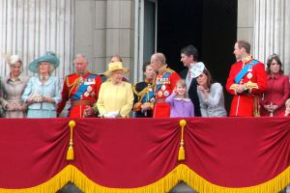
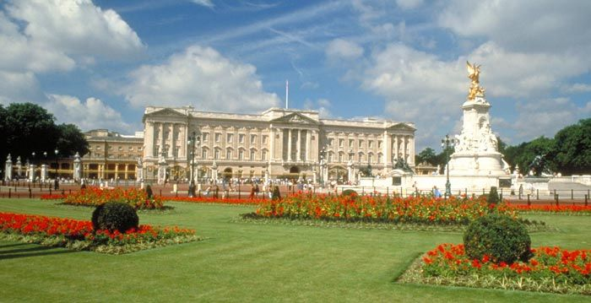
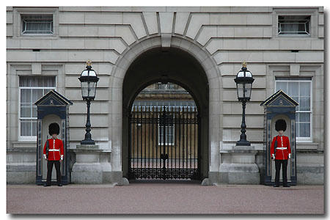
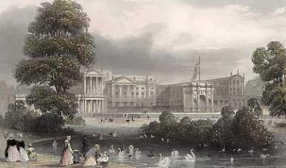
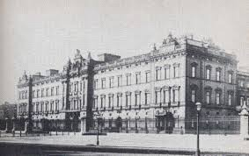
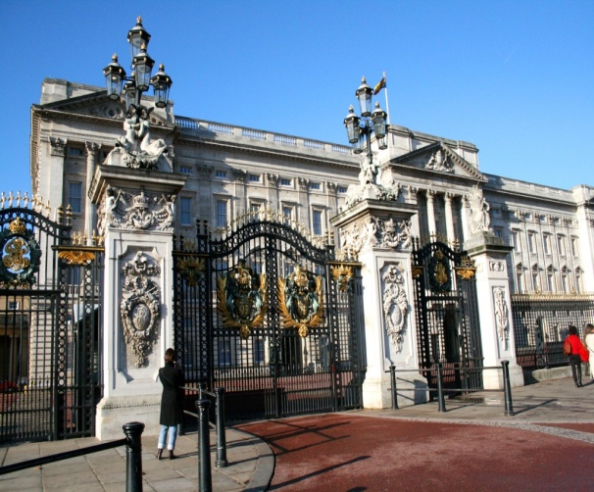
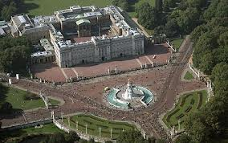
Buckingham Palace
XVIII and XIX century England.
Located in the heart of London in the city of
Westminster, the palace is often
at the centre of state
The history of the original building dates back
to the early 1700’s and finally became the official
residence of the British monarch in 1837 after
Queen Victoria came to the throne.
Buckingham palace
Buckingham Palace is the Queen’s official and main royal London home.
British royal family
the guard Buckingham palace hours

Slide 5
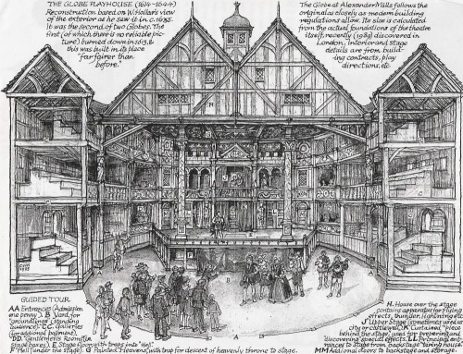
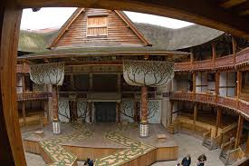
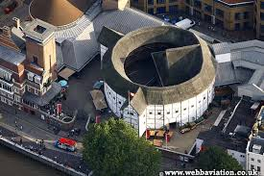
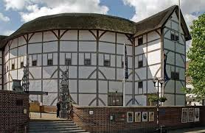
The new globe theatre: XX century England.
The Globe Theatre was a theatre in London
associated with William Shakespeare. It was built
In 1599 by Shakespeare’s playing company, and
was destroyed by fire on 29 June 1613.
A second Globe theatre was built on
the same site by June 1614 and closed in 1642.
A Modern Reconstruction of the Globe,
named “Shakespeare’s Globe”.
Opened in 1997 approximately 750 feet from
the site of the original theatre.
GLOBE THEATRE « SHAKESPEARE’S GLOBE »

Slide 6
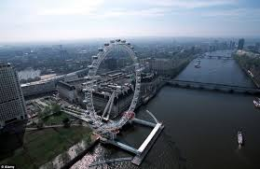
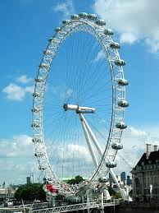
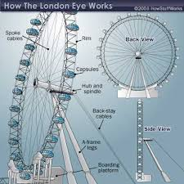
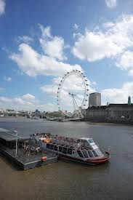
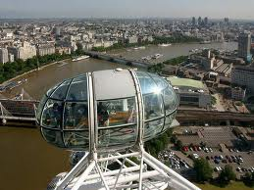
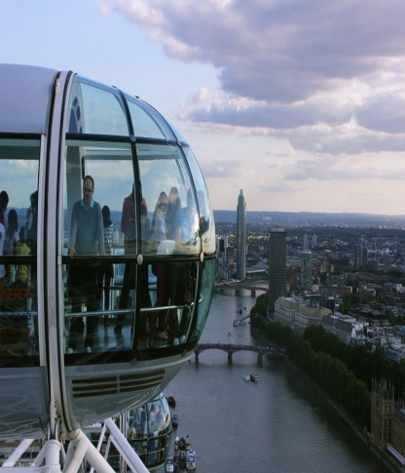
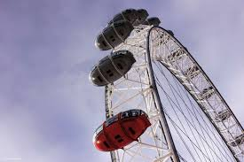
LONDON EYE
XXI century England.
The giant observation wheel has become
a London icon since its opening on the South Bank in 2000.
Designed by Marks barfield ,
the London Eye ( aka the Millennium wheel )
offers stunning views across of the capital .

Slide 7
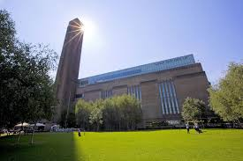
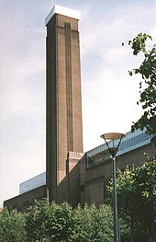
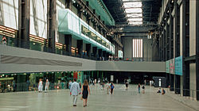
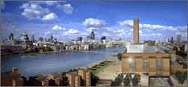
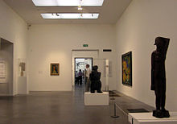
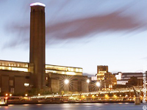
XXI century England.
Gallery of international
Modern art situated on
Bankside-Opened May 2000
Tate modern displays
the Tate collection of international modern
and contemporary art
from 1900 to the present day .
TATE MODERN
Chimney of Tate Modern.
The Turbine Hall
A gallery at Tate Modern.

Slide 8
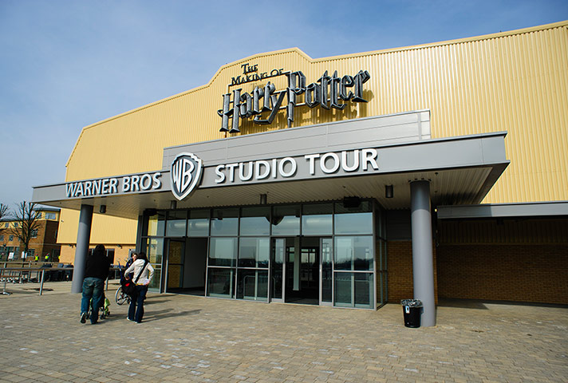
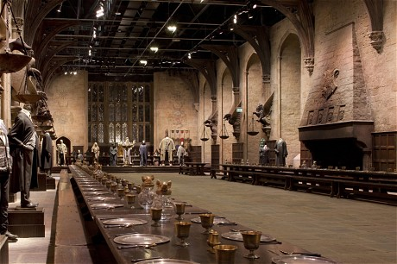
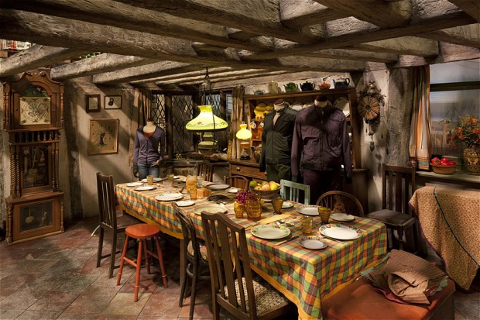
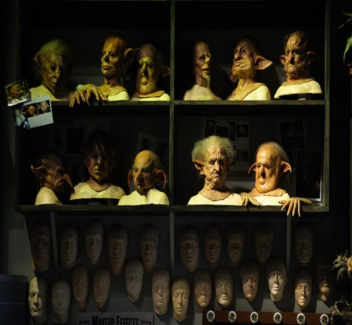
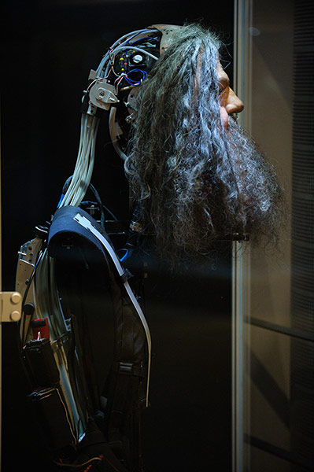
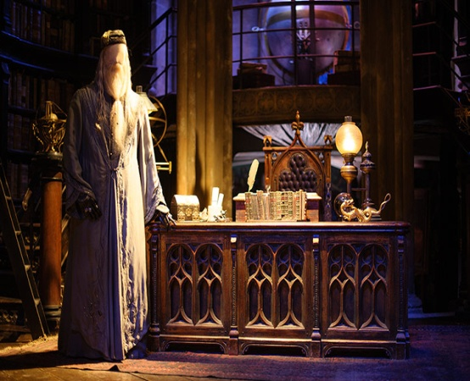
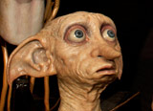
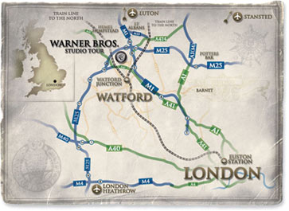
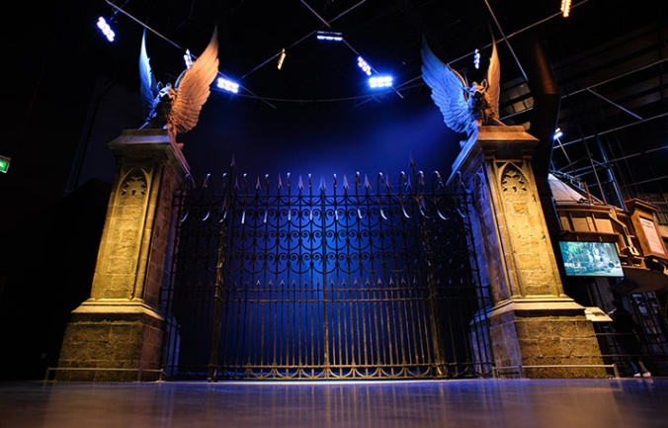
MY FAVORITE SITE : HARRY POTTER
Exterior of Harry Potter Studio Tour
The Great Hall inside Hogwarts
XX and XXI century leavesden United kingdom
Leavesden aerodrom : 1939
Leavesden studio : 1994
Warner Bros studio : 2010
Warner Bros studio Tour London: 31.03.2012
The Weasleys' kitchen
Creature Props
Harry Potter Tour Map

Slide 9
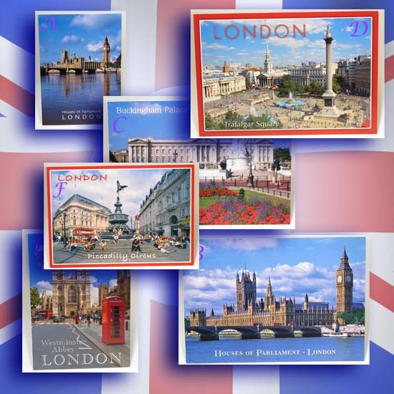
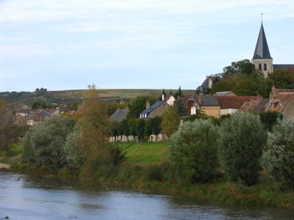
KEEP CALM
AND
SAY GOODBYE
TO LONDON
HELLO POUILLY SUR LOIRE

